Slide 1
Gold Price Prediction Project
Mentorness Internship
Name: Fahad Ur Rehman

Slide 2
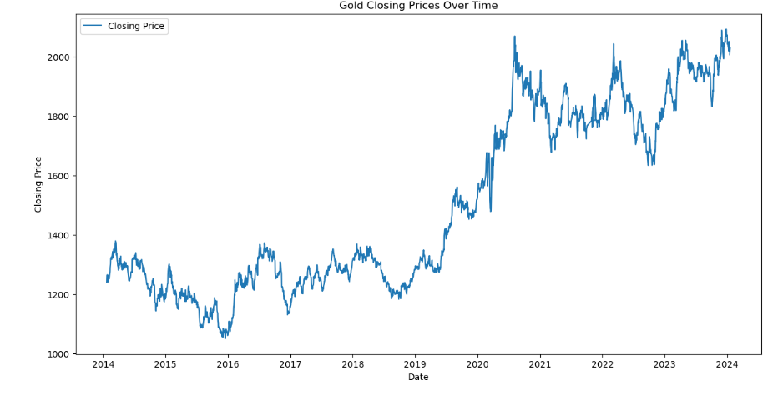
Closing Price
The chart illustrates the overall increasing trend in gold prices over the past decade, with significant volatility in recent years. This trend could be influenced by various economic factors, including market demand, global economic conditions, and geopolitical events.

Slide 3
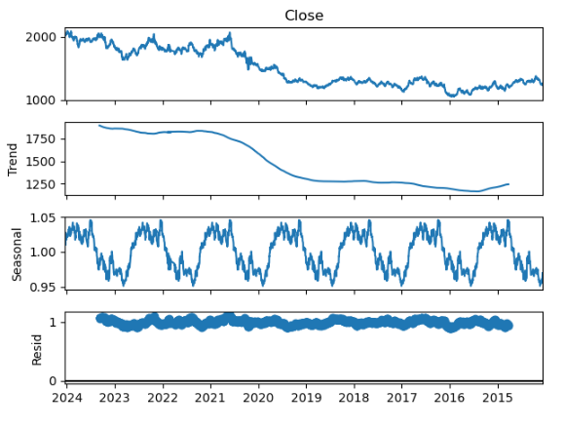
Seasonal Decomposition:
Downward Trend: The long-term trend of gold prices is downward, with a significant decline followed by a slight recovery towards the end of the period.
Seasonal Pattern: There is a clear seasonal pattern in gold prices, with regular fluctuations occurring annually.
Effective Decomposition: The residuals are well-behaved, suggesting that the decomposition model has effectively captured the trend and seasonal components.

Slide 4
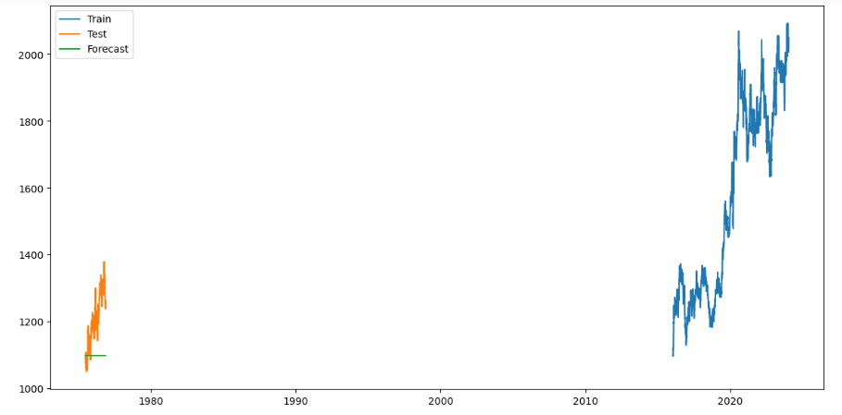
ARIMA Model for Forecasting:
The plot illustrates the use of historical gold prices for model training and testing, with a brief forecast provided. This approach helps in understanding how well the model can predict future gold prices based on past trends.

